Slide 1
Introduction to .Net Core 1

Slide 2
Web Development Background
MVC
Razor
Project Structure
Data State
Email management
Error Debugging

Slide 3
Web Development
Today, web developers are increasingly in demand. No company can do without a web presence, so it will need an IT professional who can structure and manage it in an appropriate and up-to-date form
Web Development is about building (developing) the application from scratch for the web. It is therefore about websites, web pages or anything else that runs on the Internet
web development refers to the development of programming source code, the creation and organization of databases, network protocols, web servers and computer security.

Slide 4
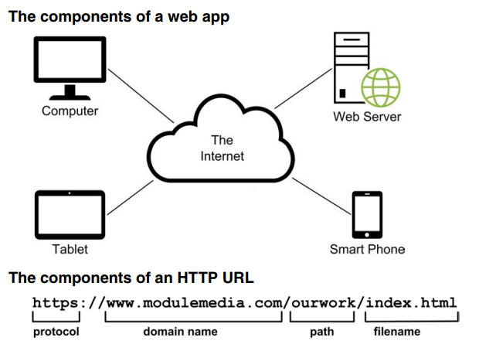
Web apps

Slide 5
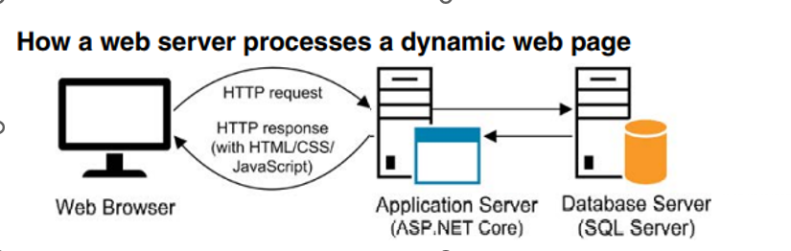
Who is the Back End Developer
Back-end Development refers to the server-side development. It focuses on databases, server side coding, website architecture

Slide 6
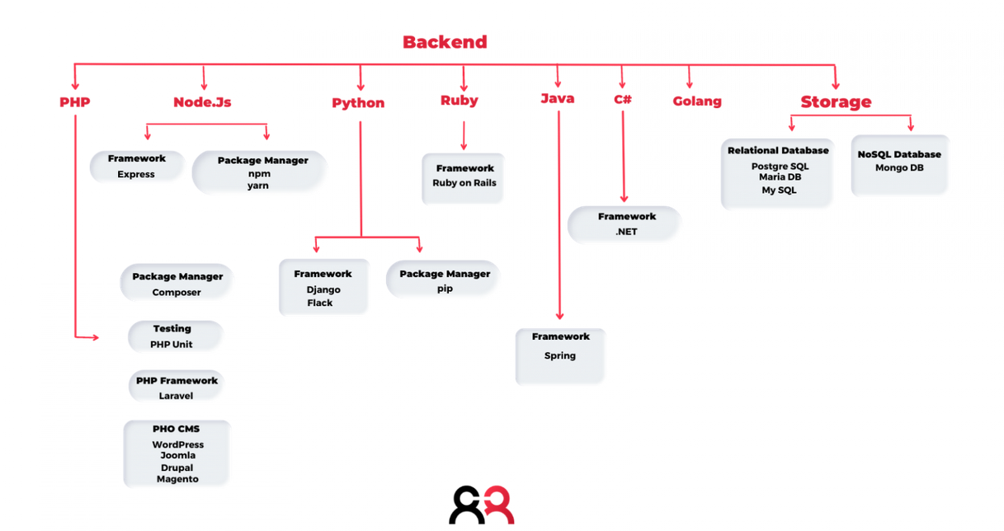
Back-end development tools

Slide 7
Back-End programmer skills
The skills of the backend programmer are:
Back-end languages (PHP, Python, Java, C#, .Net , Node js, etc.);
Databases, where developers store the data they need to manage. The types of database is versatile and adapt to the needs of the system;
Server, it is important for a backend developer to be able to take care of the of the site and its maintenance.

Slide 8
What the Full Stack Developer does
The ability to develop both the front end and the back end of a website.
An IT professional capable of dealing with the structure of web pages, their styling, animations, creating data structures, designing databases and implementing site functionality. Full Stack developers are familiar with all languages: HTML, CSS, JavaScript, PHP, Python, etc.
Despite this vast knowledge, it is very difficult for such professionals to develop a website completely on their own. In fact, their task is mainly to collaborate with front and back end developers and support them in the realization of particular functionalities.

Slide 9
ASP.NET
ASP.NET is one of the most popular web development technologies
The first version WebForms was released in 2002 by Microsoft
ASP.NET has experienced rapid growth among the corporates, as well as freelance developers.
Microsoft had introduced ASP.NET Mode-View-Controller (MVC) architecture. in .NET in 2008
In 2014, Microsoft announced a dramatic shift in the way .NET exists by presenting .NET Core, a new cross-platform, cloud-friendly, and open-source version of the framework
Also, in 2016, Microsoft acquired Xamarin, previously a proprietary technology for cross-platform mobile development, making it open source as well.
in 2019, a big release that unified the whole ecosystem: All .NET products will be bundled in the .NET 5 development platform. That means developer will be able to build applications on Windows, Linux, macOS, iOS, watchOS, Android, tv OS with just a single .NET.
Notes:
هي واحدة من أكثر تقنيات الويب شعبية
تم اطلاق اول نسخة ب2002 ومنذ ذلك الوقت تستمر مايكروسوفت في تطوير هذه اللغة
- ميزاتها : - تطوير بيئة عمل متكاملة تسمى مايكروسوفت فيجوال سدتيو

Slide 10
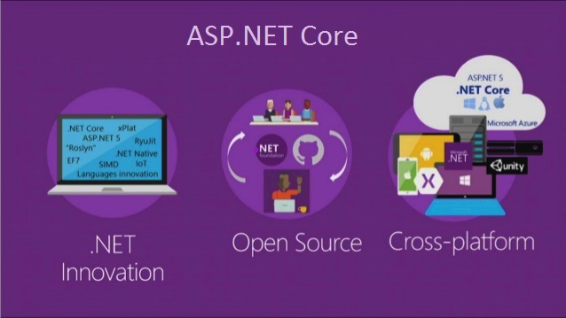
ASP.NET Core MVC framework
ASP.NET Core is a cross-platform, high-performance, open-source framework for building modern, cloud-enabled,
With ASP.NET Core, you can:
Build web apps and services, Internet of Things (IoT) apps, and mobile backends.
Use your favorite development tools on Windows, macOS, and Linux.
Deploy to the cloud

Slide 11
The benefits of using MVC include:
• Makes it easier to have different members of a team work on different components.
• Makes it possible to automate testing of individual components.
• Makes the app easier to maintain
ability to create websites rapidly

Slide 12
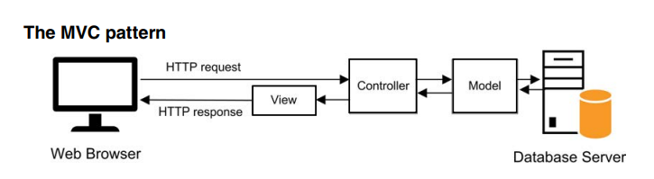
MVC
The model consists of the code that provides the data access and business logic.
• The view consists of the code that generates the user interface and presents it to the user.
• The controller consists of the code that receives requests from users and gets the appropriate data and stores it in the model, and passes the model to the appropriate view.
Usually for each table entity (Student, Class, Teacher, etc.) in the database a specific Model View Controller is created

Slide 13
MVC
In the RegisterRoutes method, the URL that is expected is the controller name, followed by a slash, and then the action.
For instance, a URL request with http://MyServer/Home/Index will have ASP.NET load the Home controller and call the Index action within that controller.
Optionally, an ID parameter can be passed for any actions that will use it.
http://MyServer/Products/Details/5 having ASP.NET
load the Products controller and call the Details action with a parameter of 5.

Slide 14
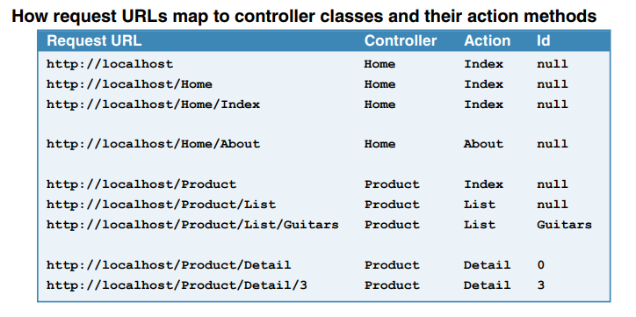
MVC

Slide 15
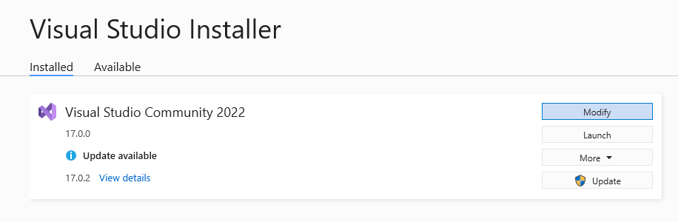
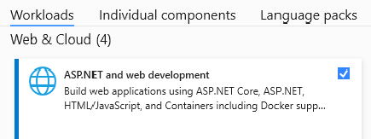
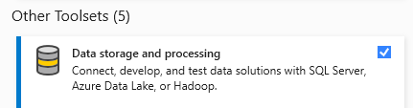
Installing Visual Studio 2022

Slide 16
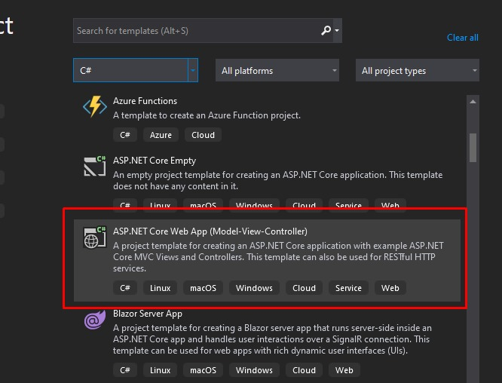
Creating ASP Core project at Visual Studio 2019

Slide 17
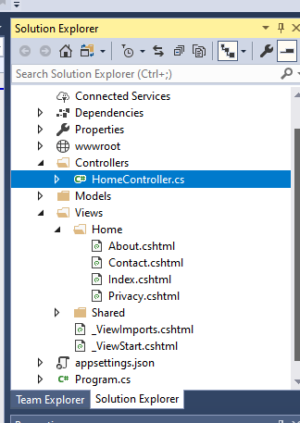
Default project structure and files
wwwroot folder Contains static assets:
Stylesheets (.css) – Here you should put your CSS style sheets
JavaScript (.js) – Here you should put your JavaScript code files
Images (.png, .jpg, etc.) – This is the folder where you should put all your images
Shared Pages The shared pages have _Layout.cshtml. This default layout file (header, navigator, footer) ) for your project. This layout will be added to all your web pages (.cshtml files).
appsettings.json Contains configuration data, like connection strings.
Program.cs Initial code for your application
All controller classes should be stored in a folder named Controllers . All controller classes should have a suffix of “Controller”.
• All model classes should be stored in a folder named Models.
• All view files should be stored in a folder named Views

Slide 18
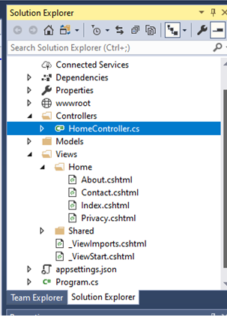
Controller View approach
HomeController
Index
Action
call
Index.cshtml
View

Slide 19
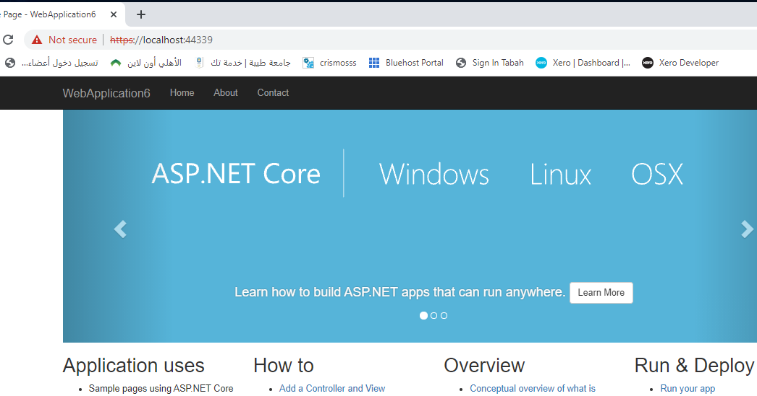
Controller View approach
public class HomeController : Controller { public IActionResult Index()
{
return View();
}
}
2
1
Click
http://MyServer/Home/Index

Slide 20
Action Definition: there are two ways of defining actions depending on the type of tasks performed
1- public IActionResult actionName(input) {}
For long processing operation such uploading files connecting with database, reading files etc.:
2- public asyn Task<IActionResult> actionName(input) {}

Slide 21
Action Calling there are two ways of calling Actions: [HttpGet]and [HttpPost]
1- use HttpGet (default)
using
Links within the view <a asp-action=“actionName"></a>
Or using Browser http://servername/controller/actionName
2- use HttpPost with form submission within the view
<form asp-action=“actionName“ method=“post”>
<input type="submit" />

Slide 22
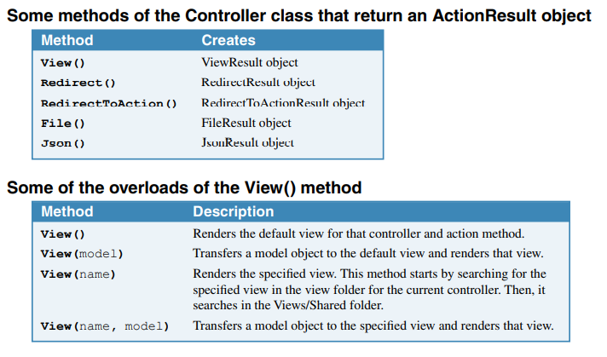
The action return statement could be used for returning different Action Result objects

Slide 23
more Examples:
return view() will call the view with the same action name
return view(new book()); calls The view with the same action name and pass empty book object
return view(“index") it will call the index view
return NotFound() produces a Status404NotFound response Page
return RedirectToAction(nameof(update)) Will redirect the response to different action (update)
return RedirectToAction(“index", “product")` Will redirect the response to different control (product) and action(index)
return view("Update", new book()); calls The Update view and pass empty book object

Slide 24
ASP.NET Razor Code Examples (for coding the Views)
Razor supports C# and uses the @ symbol to transition from HTML to C#.
That’s why its file extension is .cshtml.
All code blocks must appear within @{ ... } brackets
@{var price=50;} <html> <body> @if (price>30) { <p>The price is too high.</p> }
@for(var i = 10; i < 21; i++) { <p>Line @i</p> } </body> </html>

Slide 25
ASP.NET Razor Code Examples (for coding the Views)
Same example with simpler style (all in a single block)
<html> <body>
@{
var price=50; if (price>30) { <p>The price is too high.</p> }
for(var i = 10; i < 21; i++) {<p>Line @i</p>}
} </body> </html>

Slide 26
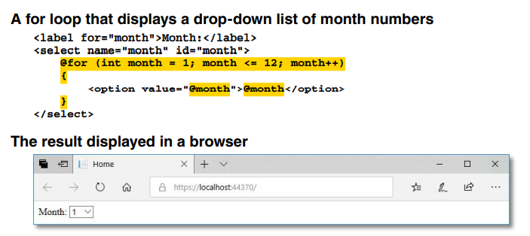
ASP.NET Razor Code Examples (for coding the Views)

Slide 27
(Sending Data from Action to View)
The State in Web Applications
1-ViewData
Used to pass variables types( int string date bool ) to the view
Allow retrieving Null Value
2-ViewBage
Used to pass variables type(int string date bool ,object/list objects ) to the view
Doesn't allow retrieving null value
3-return view(model object/list objects)
Used to pass (model object/list objects) to this action view
@Model
Note: you can use the above three types at the same time
1-ViewData[“VarName"]
return view()
View
Action
2-ViewBag.VarNane
return view()
3-return view(model)

Slide 28
Sending Data from View to Action
State in Web Applications
View
Action
1-Form Submit (input data
2- a link <a asp-action="" asp-route-id=“Id”

Slide 29
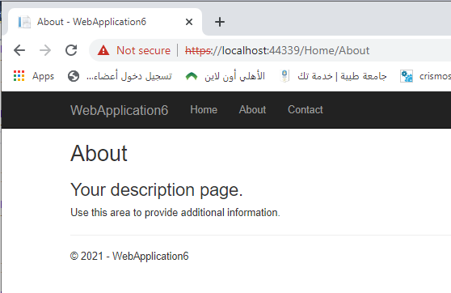
Example
public IActionResult About()
{
ViewData["Message"] = "About";";
ViewBag.Message= “Your description page1.";
return View();
}
In the view About.cshtml file
<h2>@ViewData[“Message"]</h2>
<h3>@ViewBag.Message </h3>
<p>Use this area to provide additional information.</p>

Slide 30
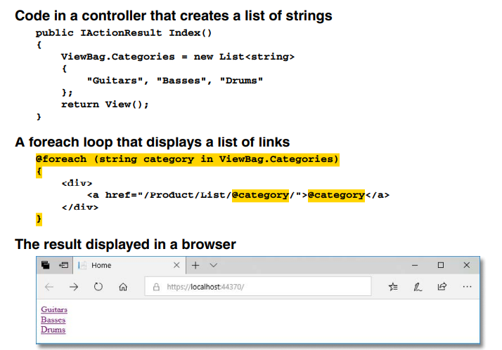
ViewBage List Example
View Code to show this list within a select component :
<select>
<option value="">select a catagory</option>
@foreach (string catagory in ViewBag.Catagories)
{
<option>@ catagory </option>
}
</select>

Slide 31
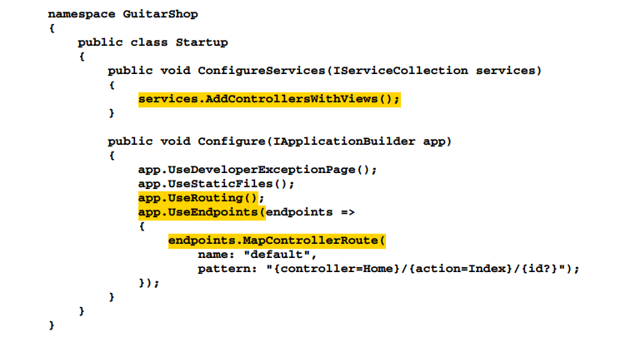
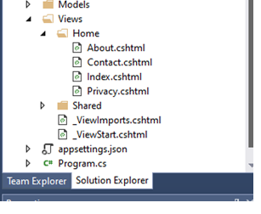
The Program.cs file : it contains the configuration code
The ConfigureServices() method contains the code that adds services to the app. For a simple ASP.NET Core MVC app, you only need to use the AddControllersWithViews() method to add services that support controllers, models, views, tag helpers, and so on.
The Configure() method contains the code that configures the services that have been added.
The UseStaticFiles specifies that the app can use the static files that are in the wwwroot directory such as the Bootstrap library.
The UseRouting Selects the endpoint for the route if one is found..
the UseEndpoints() method maps the controllers and their actions to a request URLs that’s known as the default route. This route identifies the Home controller as the default controller and the Index() action method as the default action. a parameter named id, and it uses a question mark (?) to indicate that this parameter is optional.

Slide 32
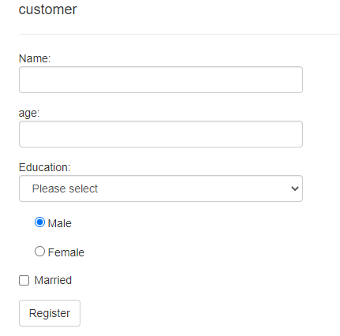
Forms Processing
For each Form view, two actions are needed
public IActionResult register()
{
return View();
}
[HttpGet] attributes is used to handles register method that handles an HTTP GET request (Default)
[HttpPost] attributes is used to handles register method that handles an HTTP POST request
[HttpPost]
public asyn Task<IActionResult> register(form’s parameters)
{
……..
}

Slide 33
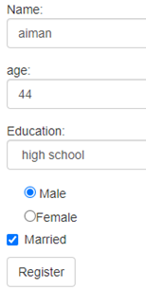

Processing a Form example
Link: <a asp-action=“register"></a> or
Browsing address: http://servername/controller/register
call
1
Register.cshtml
Controller
register View
public IActionResult register()
{
return View();
}
2
[HttpPost]
public asyn Task<IActionResult> register( parameters)
{
……..
}
3 Insert Data
4
data

Slide 34

Passing Text data from a Form to Action
Name attribute is used to send data to action
Register Form
Name: <input name="na" />
na
public asyn Task<IActionResult> register (string na ..
aiman
aiman

Slide 35

Passing Select data
<select name="education">
<option value="HH">high school</option>
<option value="UU">university</option>
</select>
education
public asyn Task<IActionResult> register(string education
HH

Slide 36

Passing RadioButton data
<input type="radio" name="gender" value="male" /> Male
<input type="radio" name="gender" value="female" />Female
gender
public asyn Task<IActionResult> register(string gender
male

Slide 37
Passing checkButton data
<input type="checkbox" name="married" value="true" />Married
married
public asyn Task<IActionResult> register(bool married
true

Slide 38
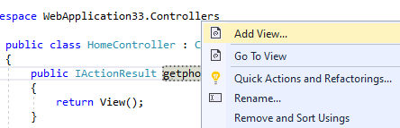
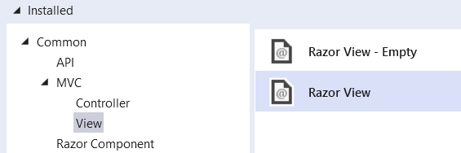
Complete Registration Example
1- Add register action and register view
HomeController.cs
3
register
1
4
2
Right Click

Slide 39
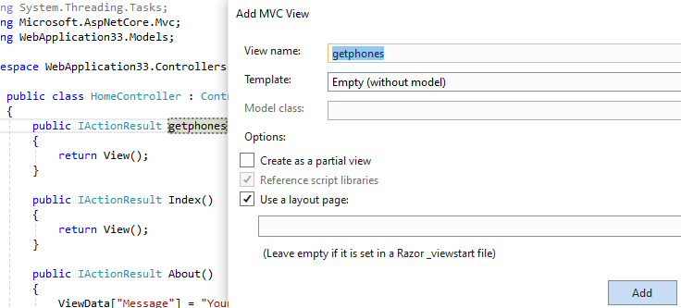
5
register
6

Slide 40
3-Complete the following html code at register view page
Register.cshtml

Slide 41
4-Complete the HttpPost register action code as following
HomeController.cs

Slide 42
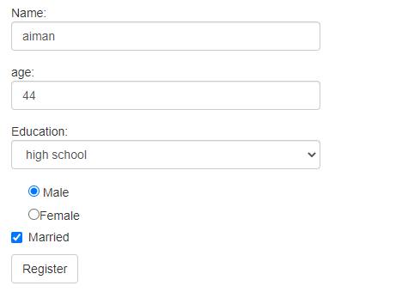
4-Complete the HttpPost register action code as following
HomeController.cs
1- Call
http://MyServer/Home/register
2-Call
[HttpPost]

Slide 43
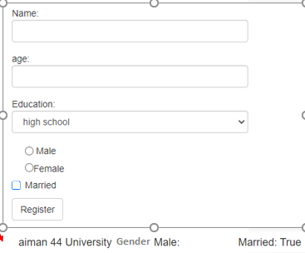
Also Note that
ASP CORE Does not support ViewState So all Input values are lost after the form submission

Slide 44
Sending Email with ASP.NET Example
SmtpClient
contains functionality for sending email
From
specifies the address from which the email message is to be sent
To
specifies the address to which the email message is to be sent
CC
specifies the carbon copy field of the email message
Bcc
specifies the blind carbon copy field of the email message
Attachments
a collection of items or files attached to the email message
Subject
specifies the subject of the email message
Body
defines the body of the email message represents a collection of email addresses
To use these methods you need first
using System.Net.Mail;

Slide 45
Note: Mail server and sending account information that are needed for Sending Emails
1- Need the address sending mail server
SmtpClient SmtpServer = new SmtpClient("smtp.gmail.com"); (e.g. for gmail)
SmtpClient SmtpServer = new SmtpClient("smtp.live.com"); (e.g. for hotmail)
2- Need the address sending account
mail.From = new MailAddress("kalaylevent@gmail.com");
3- Need the mail server port number
SmtpServer.Port = 587;
4- Need the sending account detail
SmtpServer.Credentials = new System.Net.NetworkCredential("kalaylevent@gmail.com", "mypassword");
………..
5- need to change your email account security setting
https://www.youtube.com/watch?v=Y_u5KIeXiVI

Slide 46
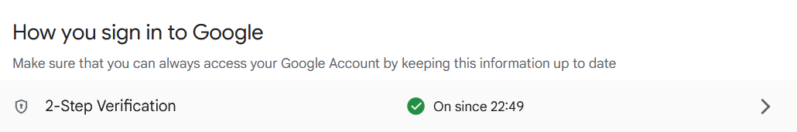
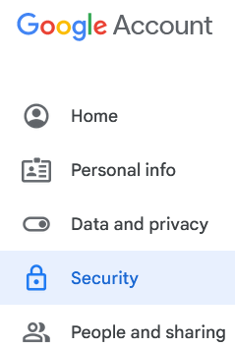
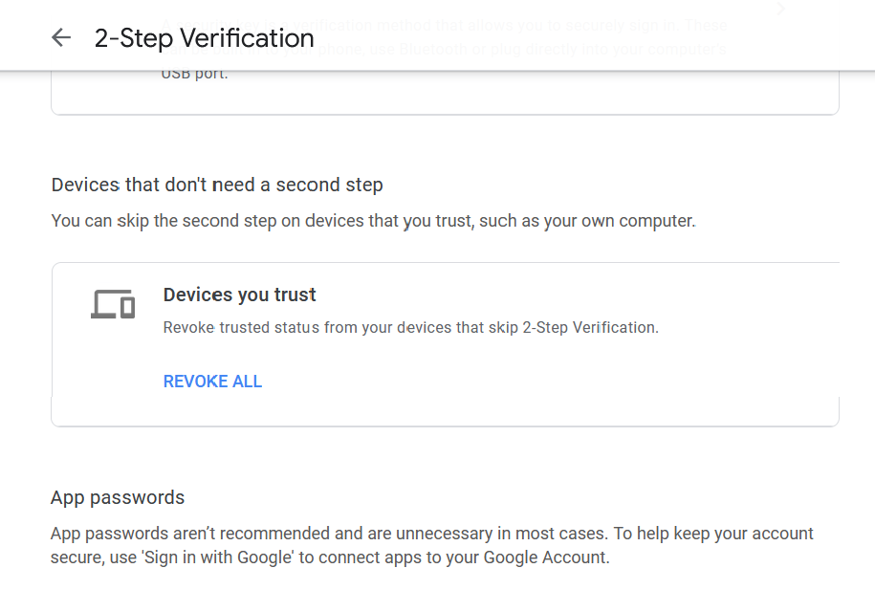
2
1
3

Slide 47
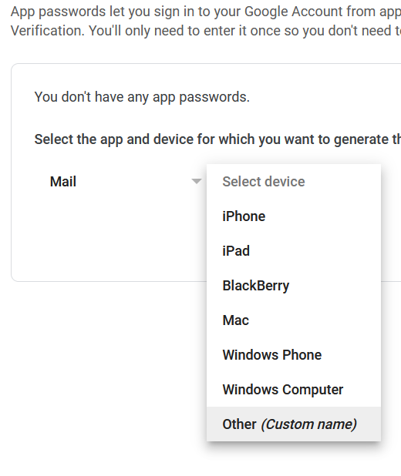
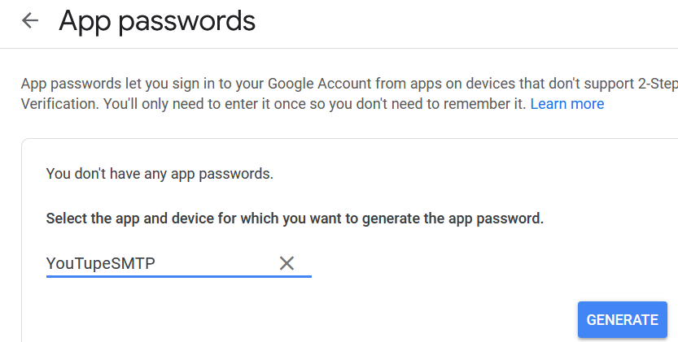
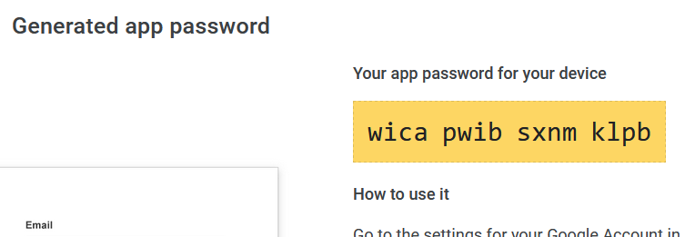
4
5
6
Type any name
7
Use this password

Slide 48
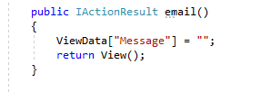
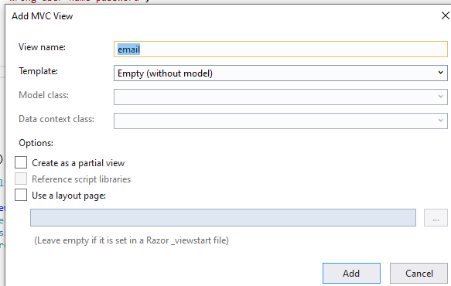
Sending Emails Example
1-Add email action at Home Control
2-Add Empty email View
HomeController.cs
Right Click

Slide 49
3- Complete the email view
Email.cshtml

Slide 50
4- Complete the HttpPost email action
HomeController.cs

Slide 51
Error Handling Syntax errors, Runtime Errors, Logical Errors
syntax errors show up at design time
runtime errors show up at run time
logic errors probably don’t show up as errors at all, they just give you the wrong result.

Slide 52
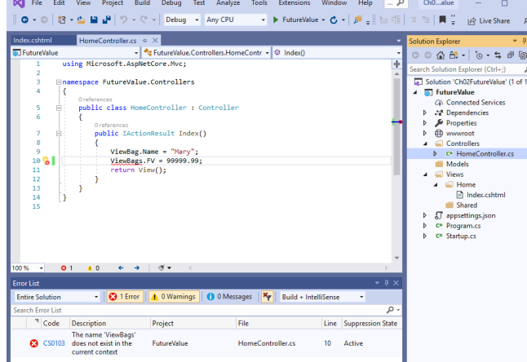
1- Syntax/Compiler Error Example
easy to catch
Move the Mouse over the error to provide more info

Slide 53
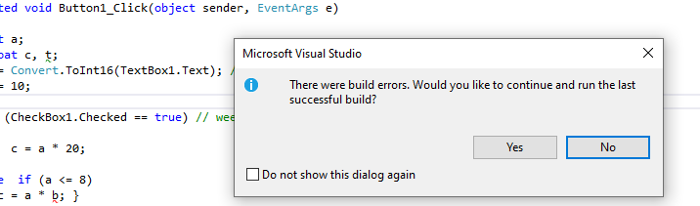
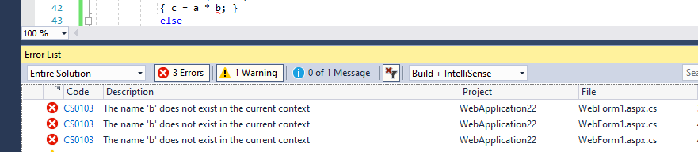
1- Syntax/Compiler Error Example
If you try to run the application that has a compilation errors
If you click on the error message it will take you to the error location

Slide 54
2- Runtime Errors
Exception handling
try
{
⋮ code block…
}
catch (Exception ex)
{
⋮ code block…
}
finally
{
⋮ code block…
}
Runtime errors occur for many reasons
DivideByZeroException
Database connection
Variables with null values
There are many others
A runtime error results when:
C# throws an exception
Exception handling allows a program to fail gracefully and recover if possible

Slide 55
place inside a Try block any code that we suspect might generate errors.
If an exception is generated (error), the code in the Catch block will be executed.
We can access information about the error from the ex object,
In the end, whether an exception occurred or not, the code in the Finally block will execute. it’s good practice to place any “mission-critical” code in that block.
For example, if database operations are performed in the Try block,
a good practice would be to close the database connection in the Finally block to ensure that no open connections remain active on the database server—consuming resources

Slide 56
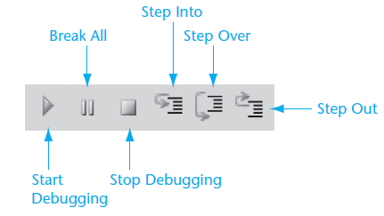
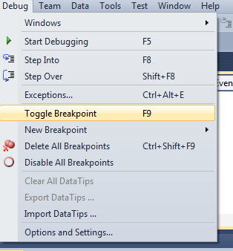
3- Debugging Logical Error (wrong result)
The most common way to get started with this kind of debugging is to set a breakpoint in the code.

Slide 57
At design time, this menu item begins execution and enters break mode at a BreakPoint before the Step into line code is executed
Step Into
Executes code one statement at a time.
If the statement is a call to a procedure, the next statement displayed is the first statement inside the procedure.
Step Over
Similar to Step Into. The difference in use occurs when the current statement contains a call to a procedure.
The next statement displayed is the statement following the procedure call.
Step Out
Executes the remaining lines of a function in which the current execution point lies.
Continue. Continue execution of the program normally by selecting Debug

Slide 58
Example
1 int kk = 0;
int hh;
2 kk++;
3 hh = f1(kk + 3);
4 string lab1 = Convert.ToString(hh);
}
}
int f1(int x)
{
5 x++;
6 return x *2;
}
Steps executing sequence
Step Into 1,2,3,5,6,3,4
Step Over 1,2,3,4
Step Out 1

Slide 59
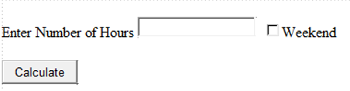
3- Debugging Logical Error (wrong result)
Calculate Salary example
Hour pay rate is 10$
If hours worked over 8 then for each hour is 15$
If weekend hours is doubled 20$
Tax is 10%
Test Case 1: Worked for 6 hours (NORMAL)
answer 6 * 10 = 60;
60 – 10% * 60 = 54 $
Test Case 2: Worked for 10 hours (OVERTIME)
Answer 8 * 10 = 80 + 2 * 15 = 30 ; total 110 ;
110 – 10% 110 = 99 $
Test Case 3: worked for 6 hours (WEEKEND)
Answer 6 * 10 * 2 = 120 ;
120 – 120 * 10% = 108 $

Slide 60
Debugging
Add a breakpoint at the top
Run the Application
Enter the value that causes error at the textbox
check the values at this breakpoint
hit the Step into
recheck the values
Keep hitting Step into
until you find error

